Slide 1
Weekly report: Tower structure
Week number: 04
Date: 21/10/2025
Supervisor: Prof. Faber
Group members:,Mohammed Eldemerdash, Ibrahim Mostafa ,Kirollos Ghaly
Speaker: Kirollos Ghaly (760171)

Slide 2
List of contents
Check Stress of the Tubular Steel structure
Sketch of tower dimensions.
Handwritten load calculations and stress analysis.
21/10/2025
Group members: Ibrahim Mostafa, Mohammed Eldemerdash, Kirolls Ghaly
Tower structure team/ Optimus Syria

Slide 3
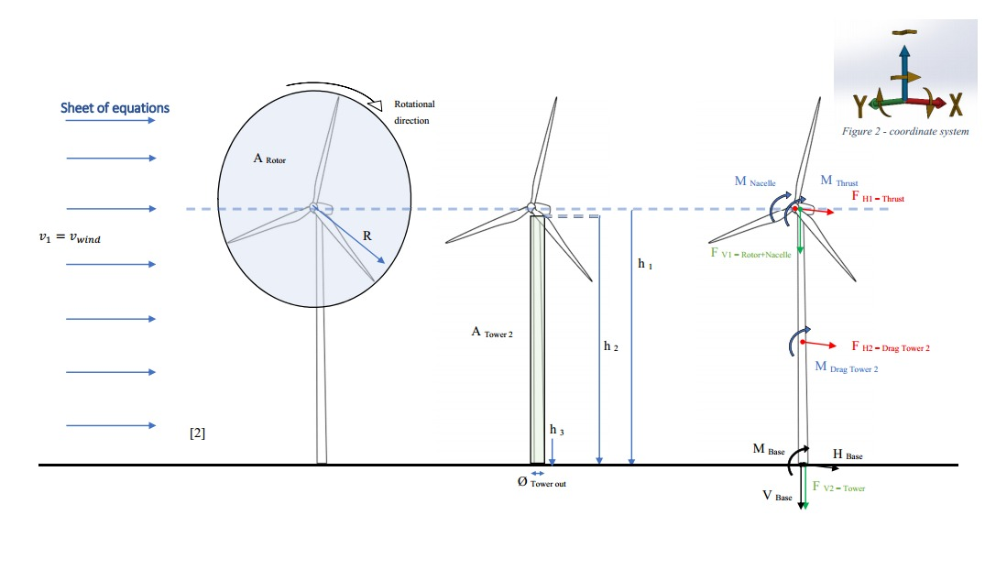
Loads calculations and stress analysis
Source: Prof. Dr.-Ing. Torsten Faber lectures
21/10/2025
Group members: Ibrahim Mostafa, Mohammed Eldemerdash, Kirolls Ghaly
Tower structure team/ Optimus Syria

Slide 4
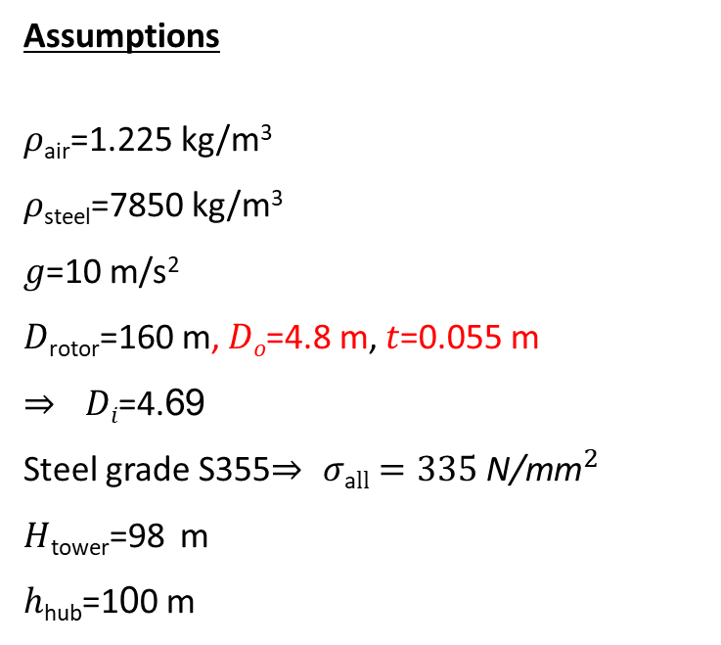
Asuumptions for the bottom section
Assumptions
𝜌_{air}=1.225 kg/m³
𝜌_{steel}=7850 kg/m³
𝑔=10 m/s²
𝐷_{rotor}=160 m, 𝐷_{𝑜}=4.8 m, 𝑡=0.055 m
⇒ 𝐷_{𝑖}=4.69
Steel grade S355⇒ $σ\text{a}ll=335 {\text{N}\text{/}\text{mm}}^{2}$
𝐻_{tower}=98 m
ℎ_{hub}=100 m
𝑚ass_{rotor}=110,000 kg
𝑚ass_{nacelle}=240,000 kg
𝑀oment_{at the top}=33000 kN
𝑀oment_{at the base}=284000 kN
Reference to data assumptions:
-Load and Dynamic team
-https://www.nrel.gov/wind/data-tools
21/10/2025
Group members: Ibrahim Mostafa, Mohammed Eldemerdash, Kirolls Ghaly
Tower structure team/ Optimus Syria

Slide 5
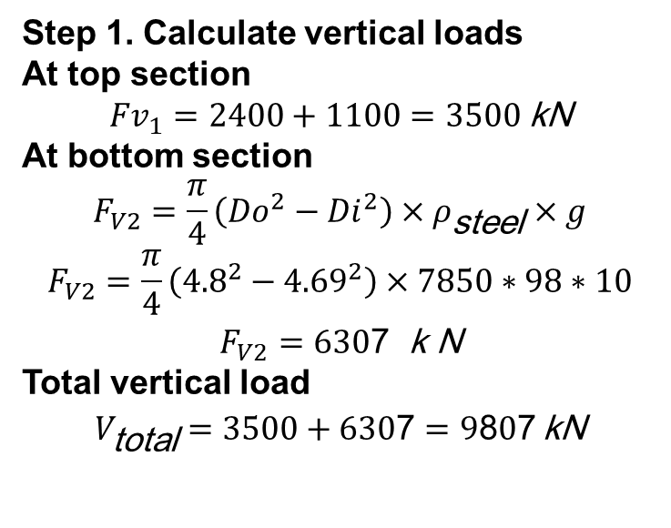
Loads calculations and stress analysis for the bottom section
Step 1. Calculate vertical loads
At top section
$${Fv}_{1}=2400+1100=3500 \text{kN}$$
At bottom section
$$F_{V2}=\frac{π}{4}\left({Do}^{2}−{Di}^{2}\right)×ρ_{\text{steel}}×g$$
$$F_{V2}=\frac{π}{4}\left({4.8}^{2}−{4.69}^{2}\right)×7850∗98∗10$$
$$F_{V2}=630\text{7} \text{k} \text{N}$$
Total vertical load
$$V_{\text{total}}=3500+630\text{7}=9\text{8}\text{0}\text{7} \text{kN}$$
21/10/2025
Group members: Ibrahim Mostafa, Mohammed Eldemerdash, Kirolls Ghaly
Tower structure team/ Optimus Syria

Slide 6
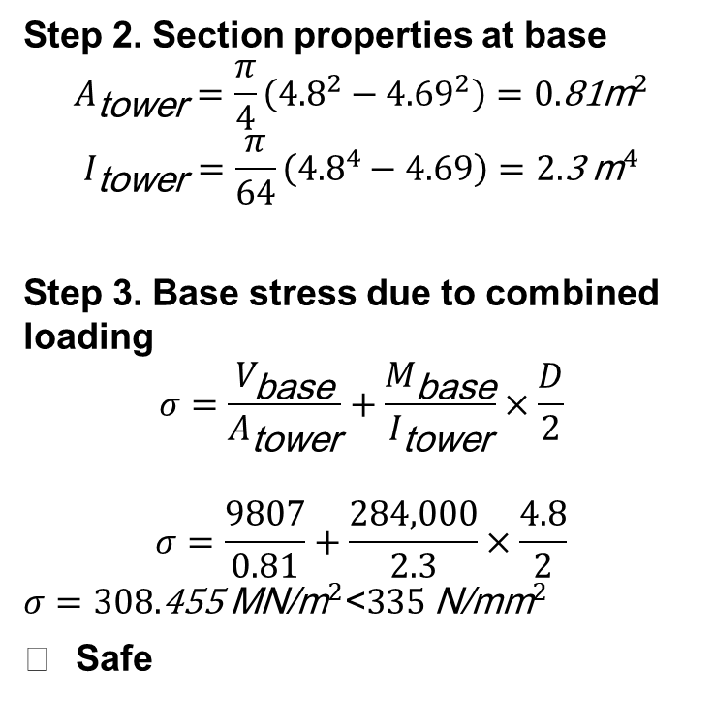
Loads calculations and stress analysis for the bottom section
Step 2. Section properties at base
$$A_{\text{tower}}=\frac{π}{4}\left({4.8}^{2}−{4.69}^{2}\right)=0.\text{81}{\text{m}}^{2}$$
$$I_{\text{tower}}=\frac{π}{64}\left({4.8}^{4}−4.69\right)=2.\text{3} {\text{m}}^{4}$$
Step 3. Base stress due to combined loading
$$σ=\frac{V_{\text{base}}}{A_{\text{tower}}}+\frac{M_{\text{base}}}{I_{\text{tower}}}×\frac{D}{2}$$
$$σ=\frac{9807}{0.81}+\frac{284,000}{2.3}×\frac{4.8}{2}$$
$σ=308.\text{455} {\text{MN}\text{/}\text{m}}^{2}\text{<}335 {\text{N}\text{/}\text{mm}}^{2}$
✅ Safe
21/10/2025
Group members: Ibrahim Mostafa, Mohammed Eldemerdash, Kirolls Ghaly
Tower structure team/ Optimus Syria

Slide 7
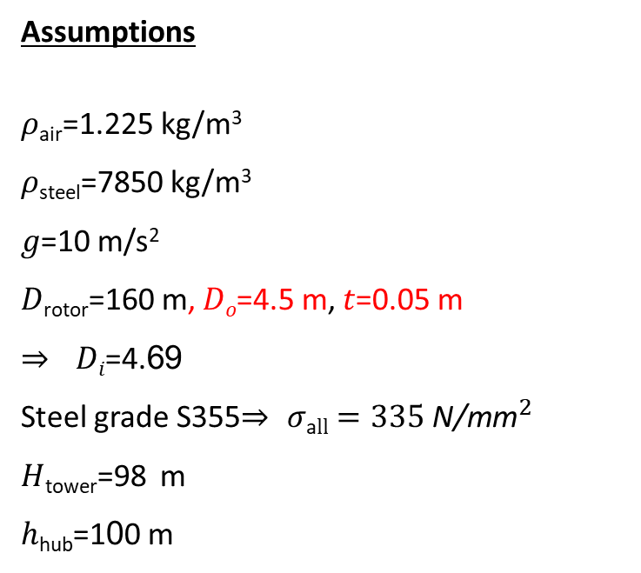
Asuumptions for the second section at height 20 from the base
Assumptions
𝜌_{air}=1.225 kg/m³
𝜌_{steel}=7850 kg/m³
𝑔=10 m/s²
𝐷_{rotor}=160 m, 𝐷_{𝑜}=4.5 m, 𝑡=0.05 m
⇒ 𝐷_{𝑖}=4.69
Steel grade S355⇒ $σ\text{a}ll=335 {\text{N}\text{/}\text{mm}}^{2}$
𝐻_{tower}=98 m
ℎ_{hub}=100 m
𝑚ass_{rotor}=110,000 kg
𝑚ass_{nacelle}=240,000 kg
𝑀oment_{at the top}=33000 kN
𝑀oment_{at the base}=284000 kN
Reference to data assumptions:
-Load and Dynamic team
-https://www.nrel.gov/wind/data-tools
21/10/2025
Group members: Ibrahim Mostafa, Mohammed Eldemerdash, Kirolls Ghaly
Tower structure team/ Optimus Syria

Slide 8
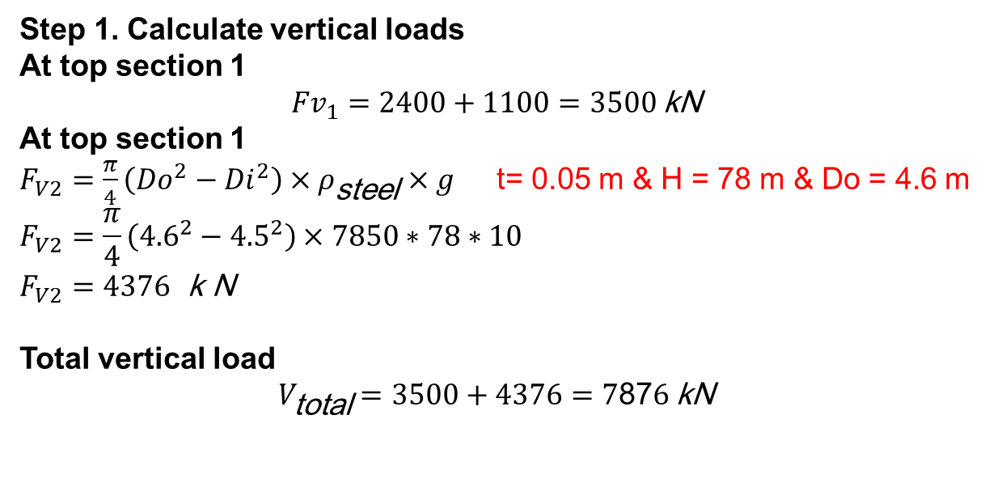
Loads calculations and stress analysis the second section at height 20 from the base
Step 1. Calculate vertical loads
At top section 1
$${Fv}_{1}=2400+1100=3500 \text{kN}$$
At top section 1
$F_{V2}=\frac{π}{4}\left({Do}^{2}−{Di}^{2}\right)×ρ_{\text{steel}}×g$ t= 0.05 m & H = 78 m & Do = 4.6 m
$$F_{V2}=\frac{π}{4}\left({4.6}^{2}−{4.5}^{2}\right)×7850∗78∗10$$
$$F_{V2}=4376 \text{k} \text{N}$$
Total vertical load
$$V_{\text{total}}=3500+4376=7\text{87}\text{6} \text{kN}$$
21/10/2025
Group members: Ibrahim Mostafa, Mohammed Eldemerdash, Kirolls Ghaly
Tower structure team/ Optimus Syria

Slide 9
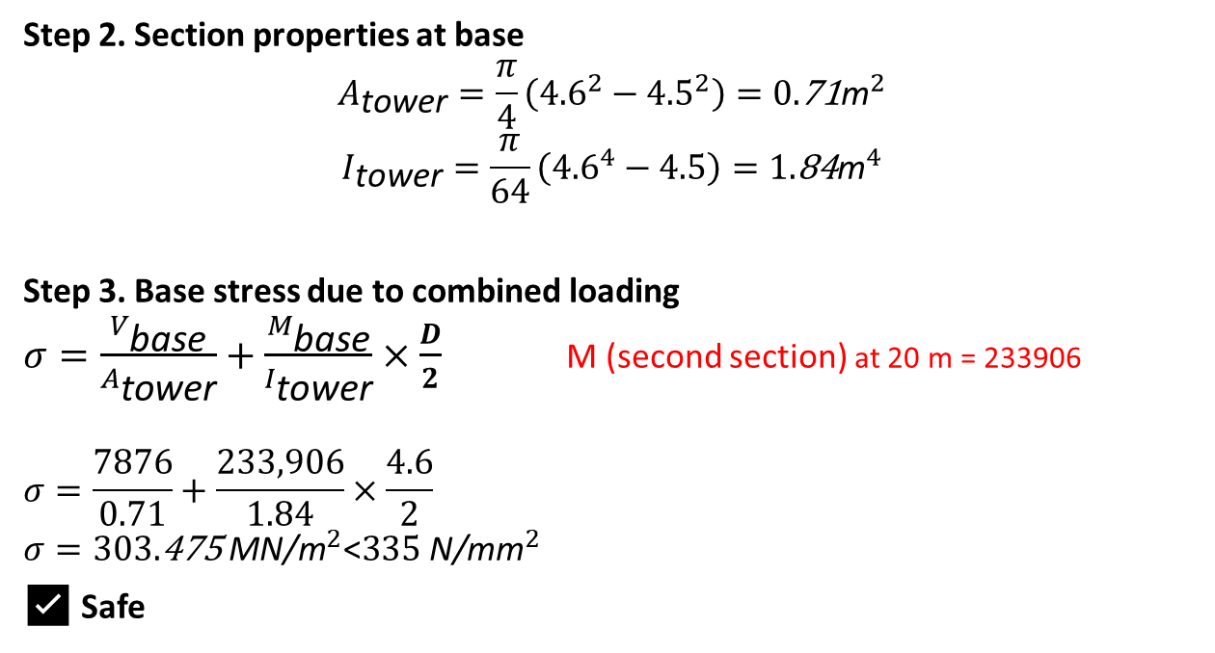
Loads calculations and stress analysis the second section at height 20 from the base
Step 2. Section properties at base
$$A_{\text{tower}}=\frac{π}{4}\left({4.6}^{2}−{4.5}^{2}\right)=0.\text{71}{\text{m}}^{2}$$
$$I_{\text{tower}}=\frac{π}{64}\left({4.6}^{4}−4.5\right)=1.\text{84}{\text{m}}^{4}$$
Step 3. Base stress due to combined loading
$σ=\frac{V_{\text{base}}}{A_{\text{tower}}}+\frac{M_{\text{base}}}{I_{\text{tower}}}×\frac{D}{2}$ M (second section) at 20 m = 233906
$$σ=\frac{7876}{0.71}+\frac{233,906}{1.84}×\frac{4.6}{2}$$
$σ=303.\text{475} {\text{MN}\text{/}\text{m}}^{2}\text{<}335 {\text{N}\text{/}\text{mm}}^{2}$
✅ Safe
21/10/2025
Group members: Ibrahim Mostafa, Mohammed Eldemerdash, Kirolls Ghaly
Tower structure team/ Optimus Syria

Slide 10
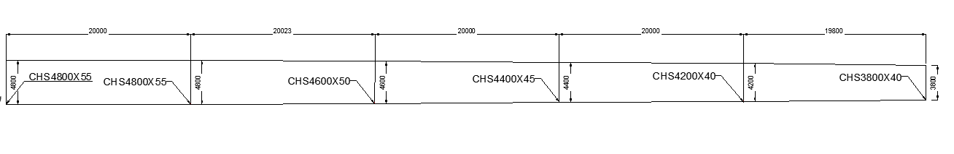
Sketch of tower dimensions
21/10/2025
Group members: Ibrahim Mostafa, Mohammed Eldemerdash, Kirolls Ghaly
Tower structure team/ Optimus Syria

Slide 11
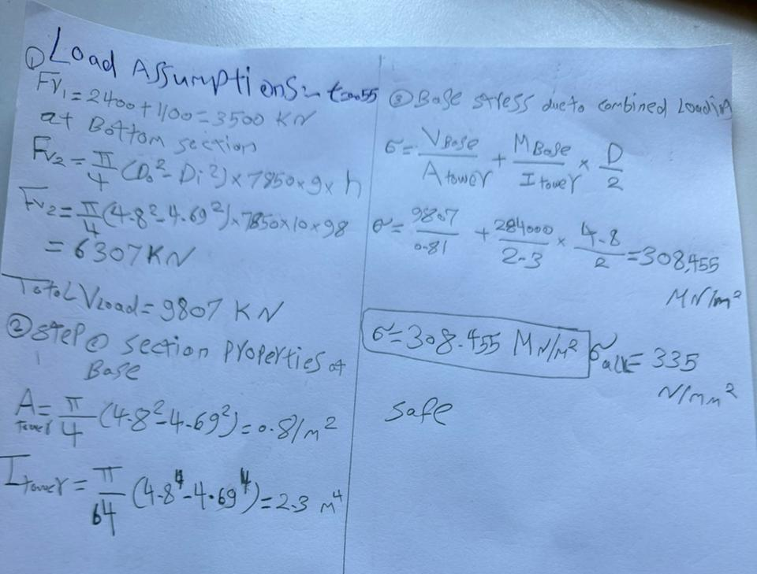
Loads calculations and stress analysis- handwritten calculations
Fig 10,11: Original handwritten calculations
Group members: Ibrahim Mostafa, Mohammed Eldemerdash, Kirolls Ghaly
Tower structure team/ Optimus Syria

Slide 12
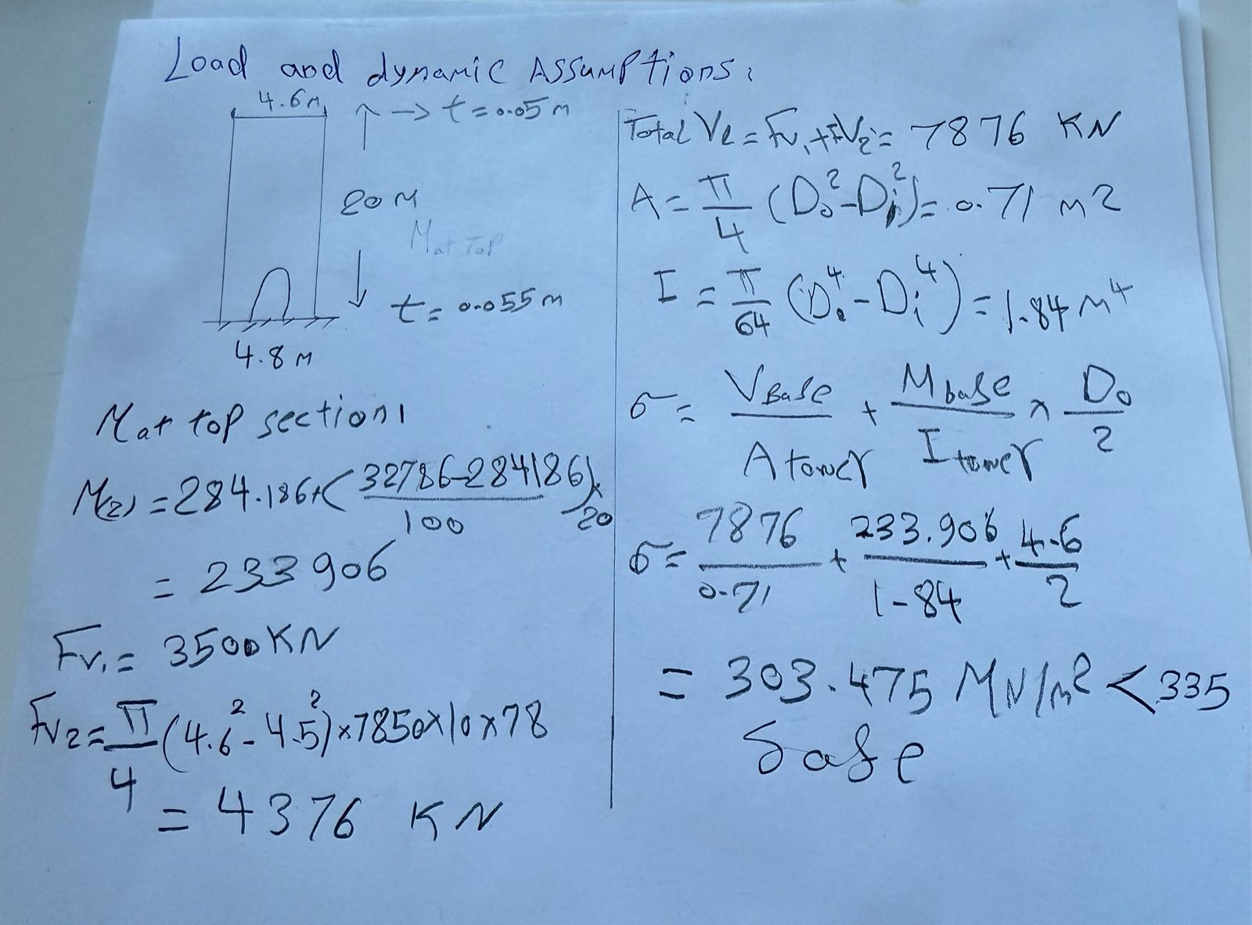
Loads calculations and stress analysis- handwritten calculations
Fig 10,11: Original handwritten calculations
Group members: Ibrahim Mostafa, Mohammed Eldemerdash, Kirolls Ghaly
Tower structure team/ Optimus Syria

